Slide 1
BGP Fast Failure Detection using BFD
INF645 Independent Project
By Nico

Slide 2
Contents
Introduction
Related research work
Platform implementation
Future outlook
Q&A

Slide 3
Introduction
Motivation for choosing this topic:
Last year’s internship at Cisco Meraki makes me feel more interested in network engineer programming
This year’s internship is still at the same team, preparing for my upcoming new project about BGP network
For my future career plan, I am looking to continue to work as a network engineer

Slide 4
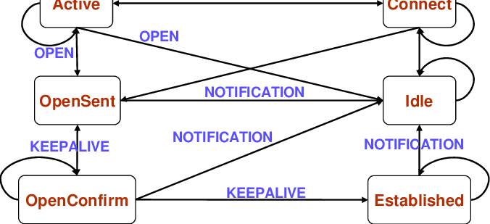
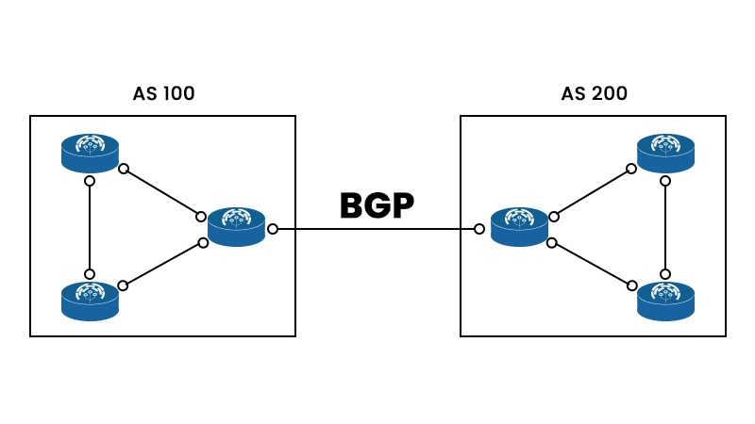
Introduction
BGP
Border Gateway Protocol: Achieves reachability between Autonomous Systems
KEEPALIVE packets for detecting network failures and rerouting(60s)

Slide 5
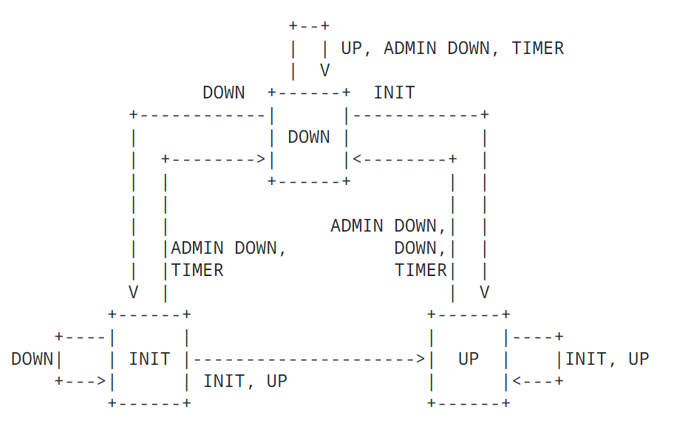
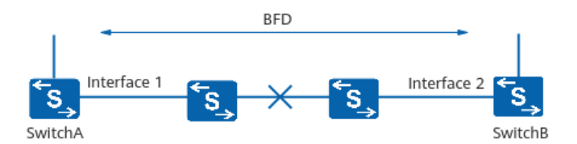
Introduction
BFD
Bidirectional Forwarding Detection
Implement light-load failure detection, which takes only milliseconds, enhancing reliability.
Quickly detect a broad range of failures, including interface, data link, and forwarding engine failure.

Slide 6
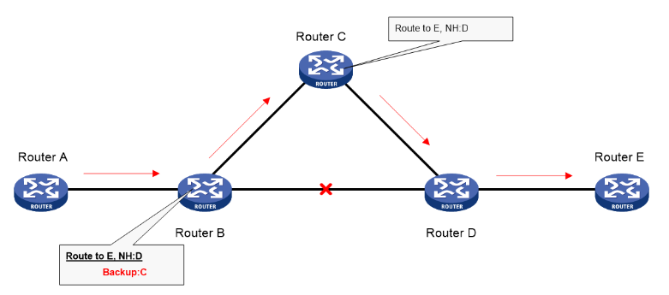
Related research work: BGP retransmission combined with BFD
Chanllenge using BGP:
Slow convergence time: BGP relies on periodic updates
Degradation of network performance and reliability.
Advantages of integrating BGP and BFD together
Reduce convergence time by instantly notifying BGP of link failures
BFD provides low overhead, short duration failure detection methods.

Slide 7
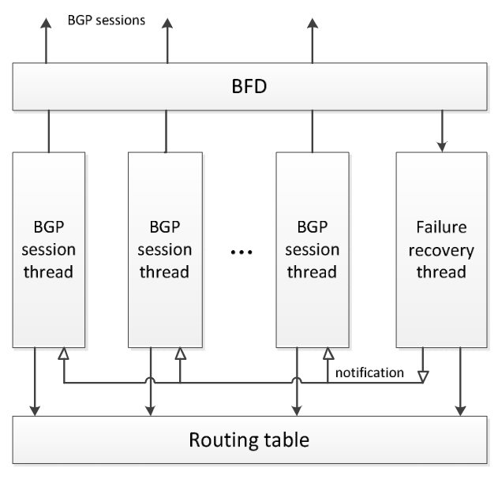
Related research work: Multithread recovery algorithm in BGP
Core idea:
Assigning the failure recovery process to multiple threads
Running in parallel with multiple BGP session threads
Dynamic Route Generation
Detection
Finding alternative path and verify
Path combination
Handling exception

Slide 8
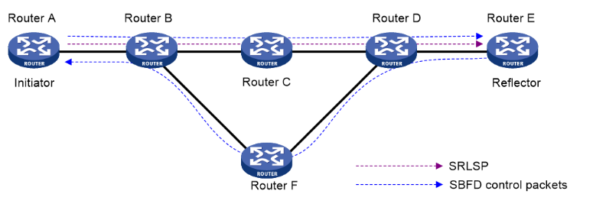
Related research work: Seamless Bidirectional Forwarding Detection
Core ideas:
Simplified BFD state machine (UP and DOWN states) to shorten session negotiation time
Shorter session negotiation time, faster detection than traditional BFD
Working mechanism
Initiator and reflector
Link state detection is required at one end

Slide 9
Related research work: Comparison between BGP and BFD
Frequency and response time:
BGP: second, layer 4
BFD: millisecond, layer 3
Protocol design:
BGP: Exchange of routing information, and KEEPALIVE messages are only a mechanism used to maintain neighbor relationships.
BFD Designed for fast failure detection, can be used in OSPF, BGP and even in hardware
Network burden
BGP: Increasing the frequency will clog up the network.
BFD: Centralize optimization of the failure detection process

Slide 10
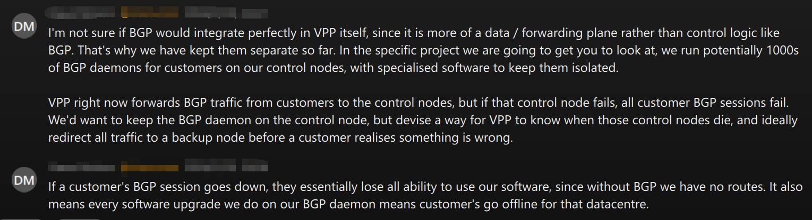
Platform implementation
Attempts to build a platform
1. VPP
Customer BGP Software -> VPP -> BGP Daemon
The entire topology needs to be configured, including the control node and forwarding node
2. FRR
Open source routing software project
Relatively complex interface configuration, not well measured and visualized
3. GNS3
Allows users to build complex virtual networks
Measurement is easy and visualization makes the network architecture clear.

Slide 11
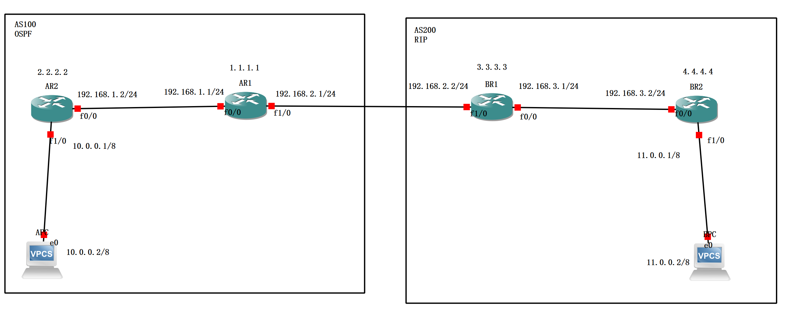
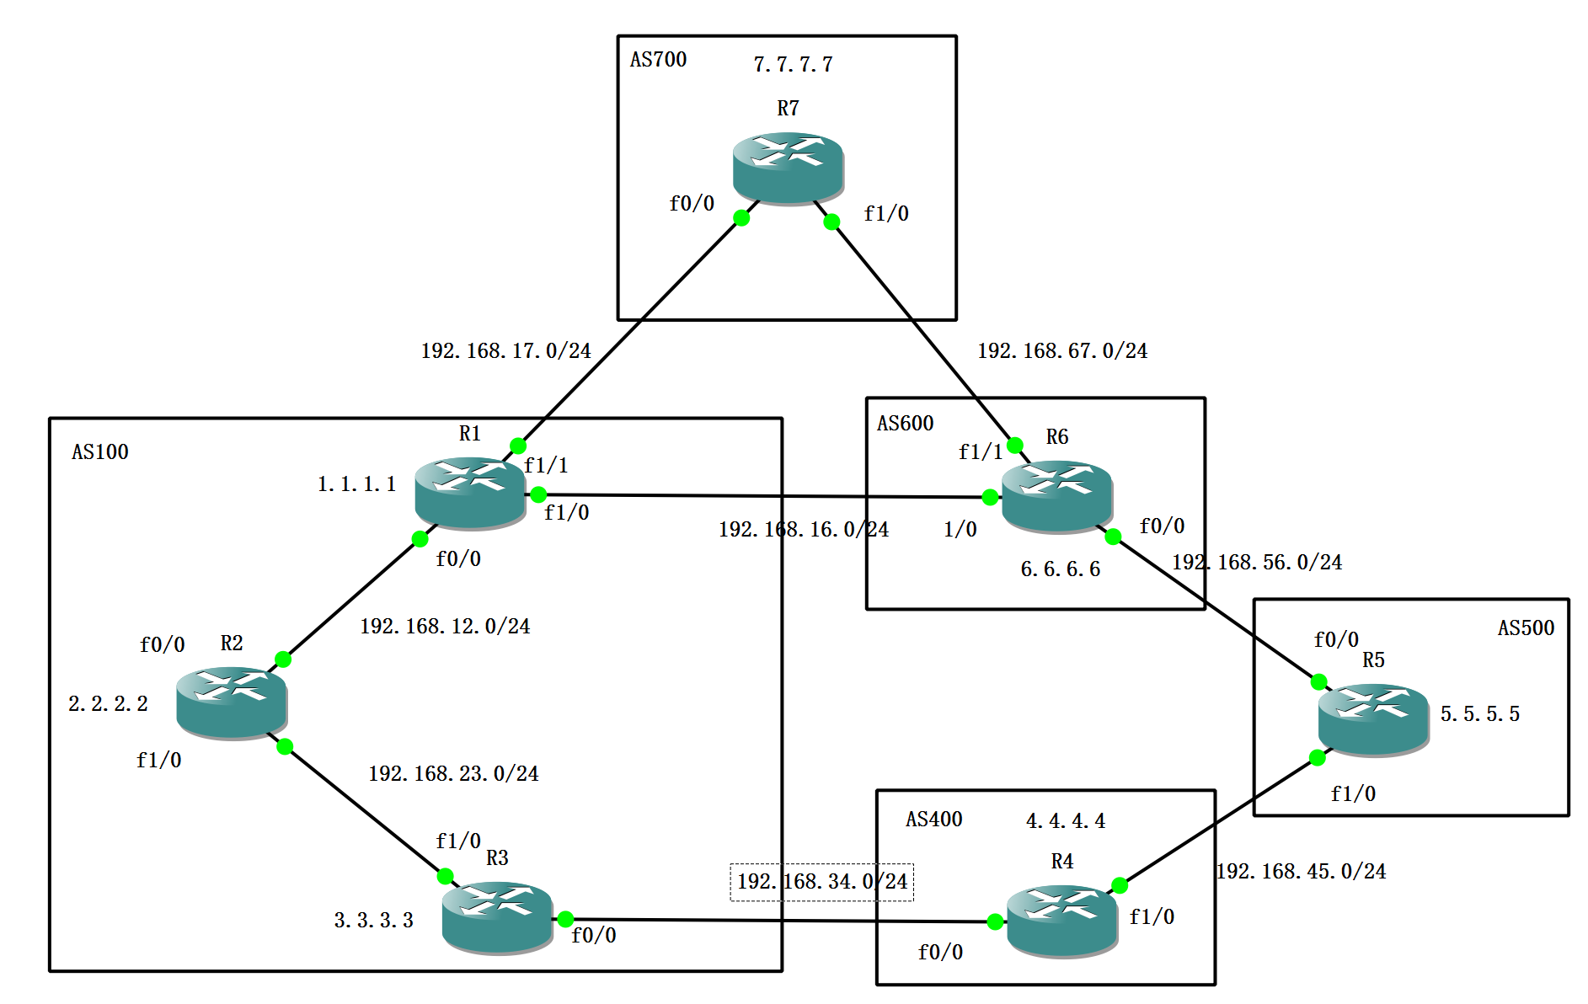
Platform implementation
1. BGP implementation between ASes with different IGP protocols
Testing the performance gains from deploying BFD on a single BGP connection
2. Platform building based on BFD link detection in BGP
Tested the deployment of BFD for BGP route convergence speed improvement between complex autonomous systems

Slide 12
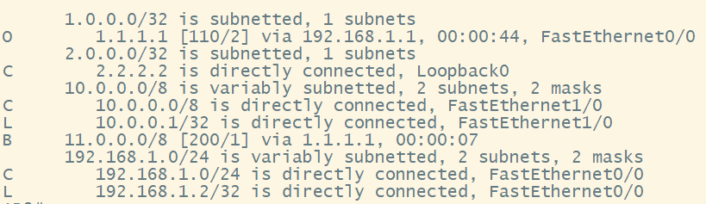
BGP implementation between ASes with different IGP protocols
AR2 route table

Slide 13
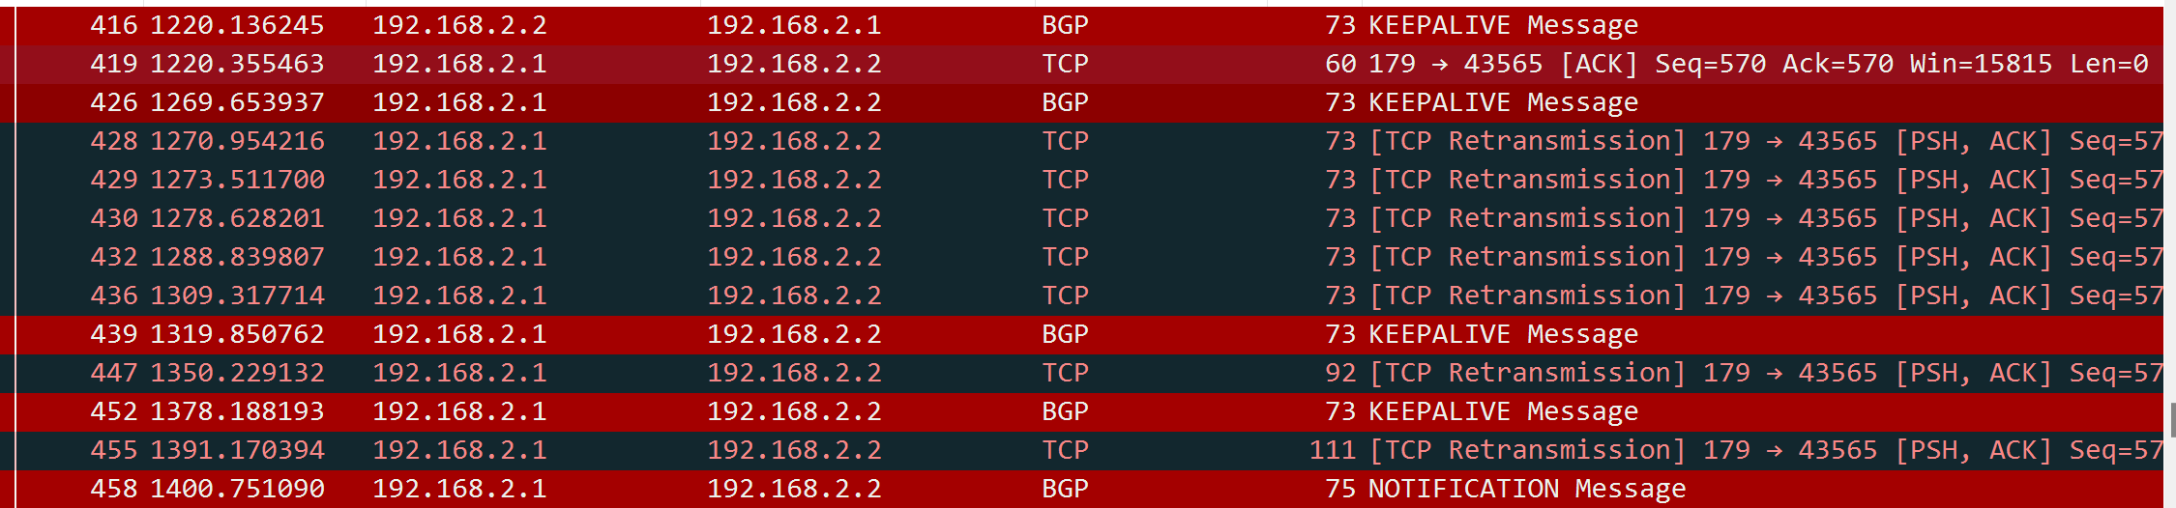
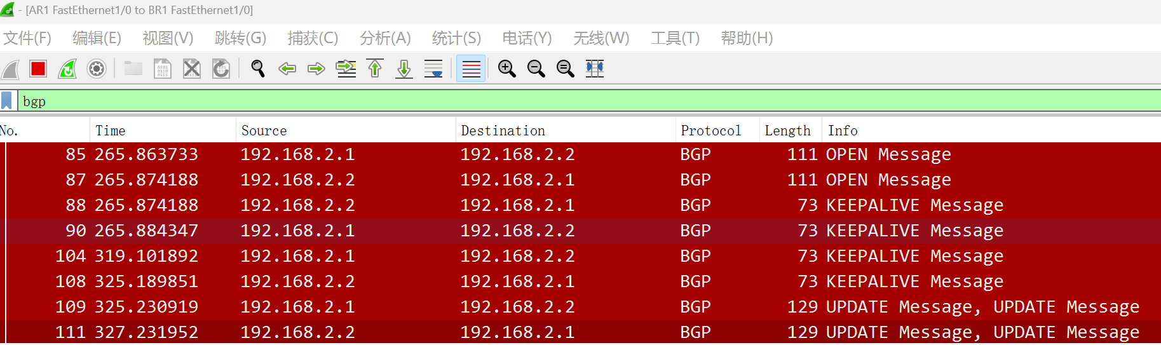

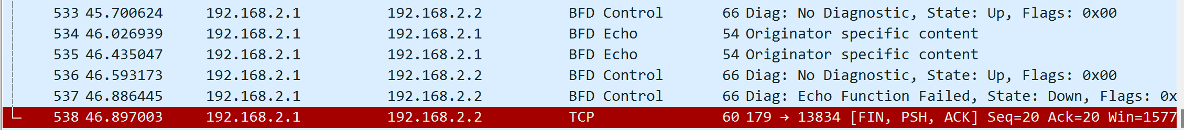
BGP implementation between ASes with different IGP protocols
1400-1200 = 200s
BFD
46.9-45.7=1.2s

Slide 14
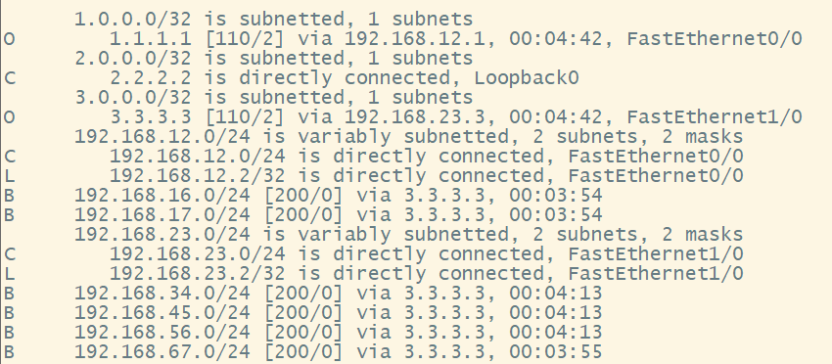
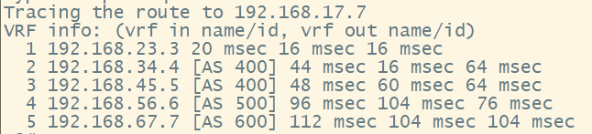
Platform building based on BFD link detection in BGP
R2

Slide 15
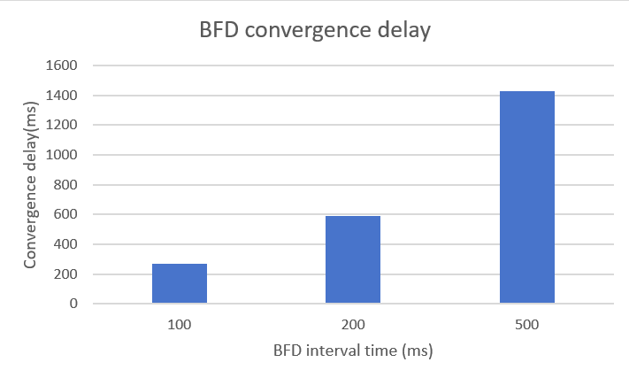
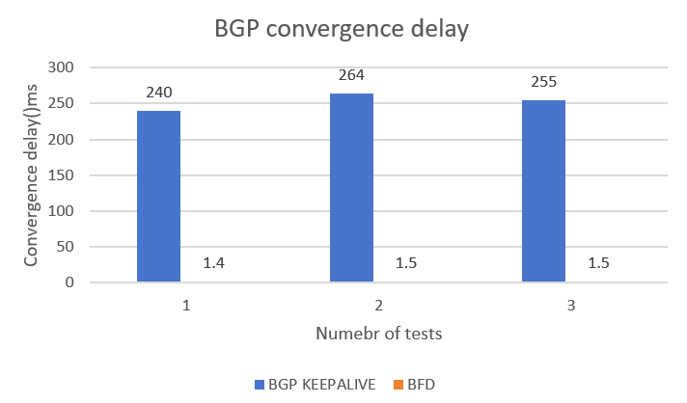
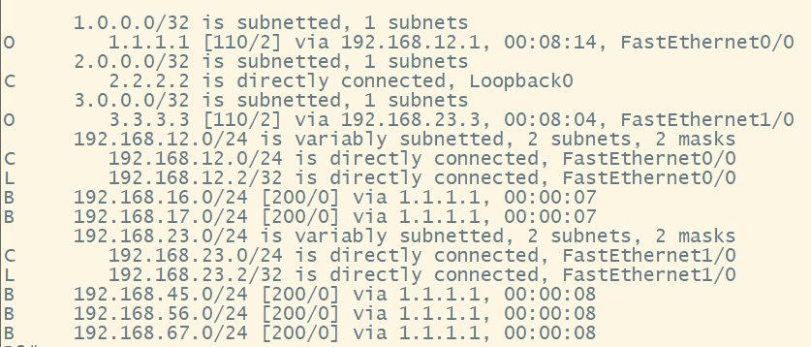
Platform building based on BFD link detection in BGP
BFD convergence delay:
BGP convergence delay:

Slide 16
Future outlook
Combine the retransmission algorithm with the BFD
Try to implement all the topology in VPP system, include BGP and BFD protocol
Explore the other usage of BFD: in IBGP, EBGP and hardware

Slide 17
Q&A

Slide 18
Thank you

